Slide 1

Lossless 3D FDTD of A 3GHZ 180$°$ Hybrid Coupler
Extraction of Network Parameters

Slide 2
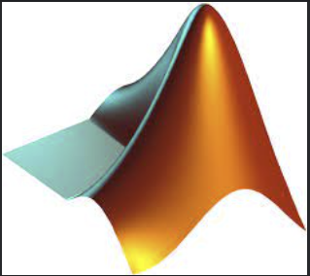

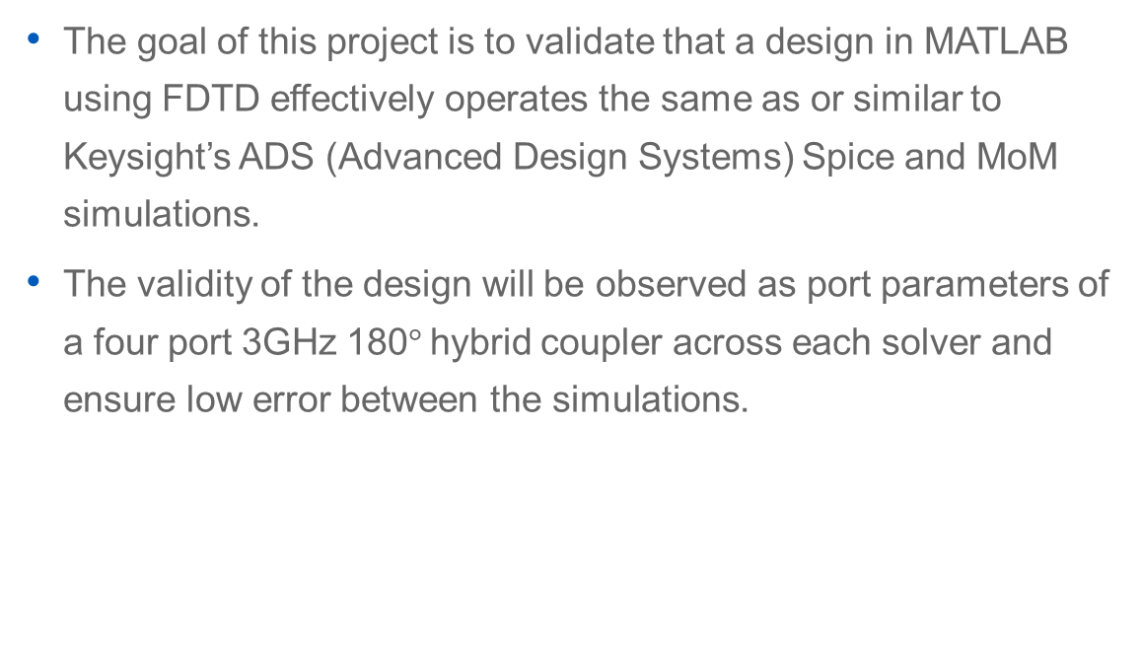
About the Project
The goal of this project is to validate that a design in MATLAB using FDTD effectively operates the same as or similar to Keysight’s ADS (Advanced Design Systems) Spice and MoM simulations.
The validity of the design will be observed as port parameters of a four port 3GHz 180$°$hybrid coupler across each solver and ensure low error between the simulations.

Slide 3
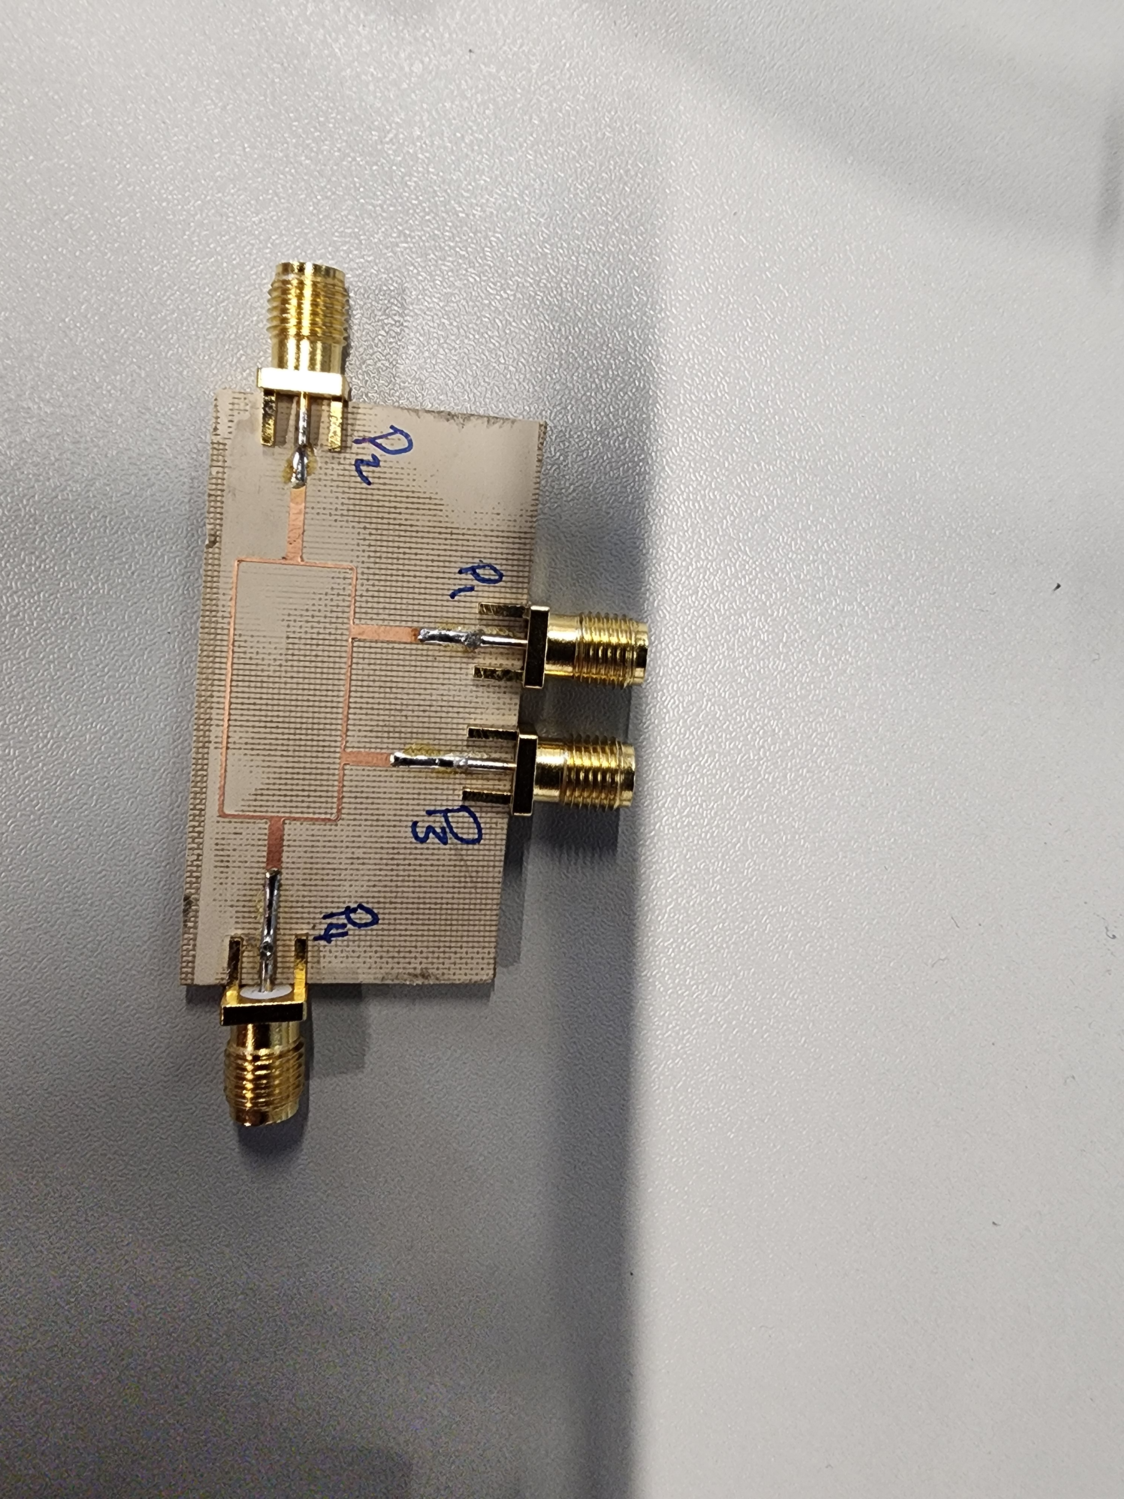
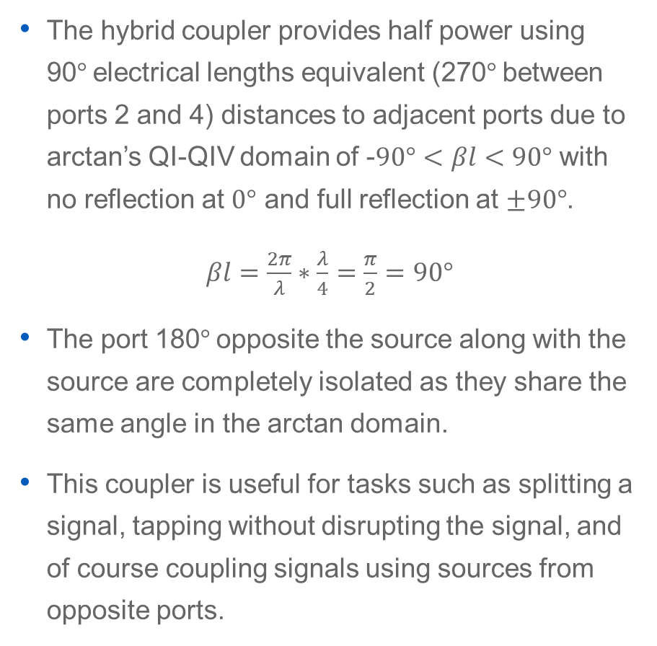

About the 180$°$ Hybrid Coupler
The hybrid coupler provides half power using 90$°$electrical lengths equivalent (270$°$between ports 2 and 4) distances to adjacent ports due to arctan’s QI-QIV domain of -$90°<βl<90°$ with no reflection at $0°$ and full reflection at $±90°$.
$βl=\frac{2π}{λ}∗\frac{λ}{4}=\frac{π}{2}=90°$
The port 180$°$opposite the source along with the source are completely isolated as they share the same angle in the arctan domain.
This coupler is useful for tasks such as splitting a signal, tapping without disrupting the signal, and of course coupling signals using sources from opposite ports.

Slide 4
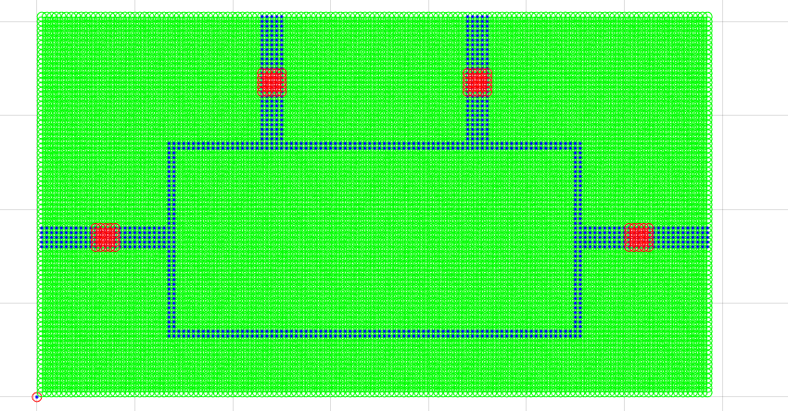
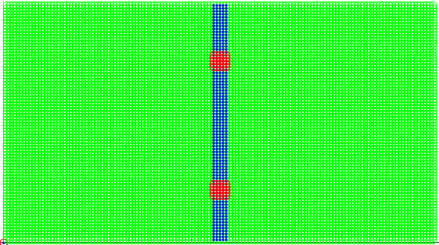
MATLAB FDTD Schematic
The model uses the same line dimensions and Roger AD1000 substrate values as both the MoM and Spice models.
A line was used to obtain reference port impedance and the forward source voltage signal on the line for removing the source signal in the for obtaining reflection parameters.
The programs first runs the line program then tests the port at each source for a total of 5 simulations to obtain all parameters.

Slide 5
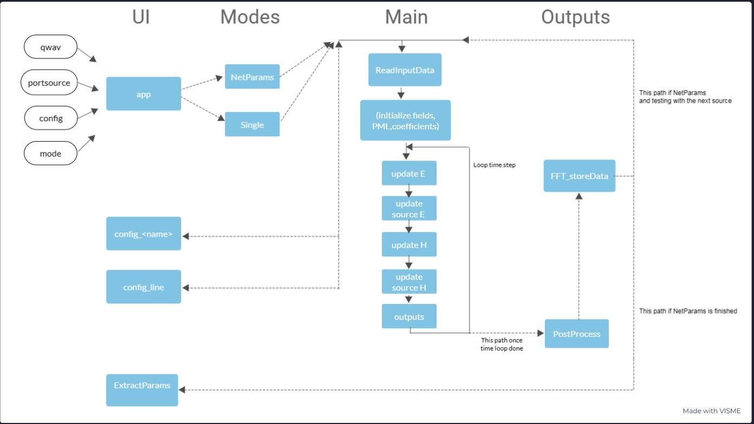

Slide 6
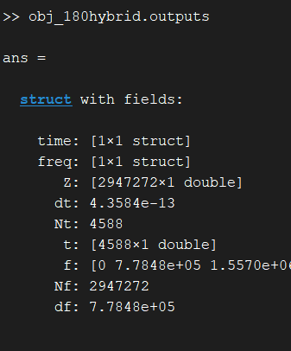
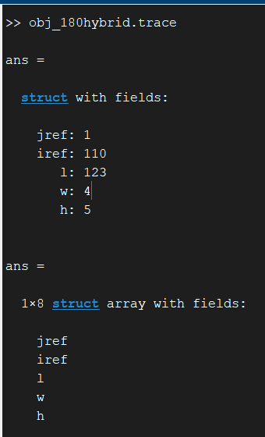
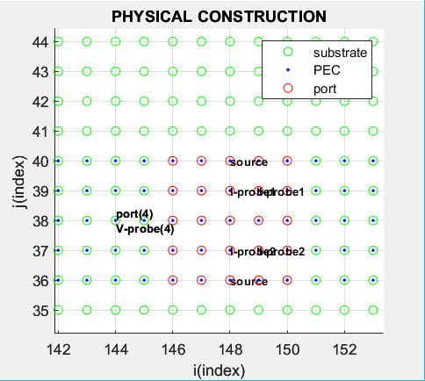

Object Orientation Design
Object orientation was used to simplify the design process to reduce time between simulations when changing PCB layouts. This was particularly useful while attempting to find the proper scaling for the design.
Traces designed were defined with a reference coordinate, width, length and height.
Ports were defined as a location which is automatically tied to the port traces where ever they move.
Sources are automatically tied to the defined ports, wherever they may be defined.
Outputs are in the form of multilevel structures for variable organization for static post processing and reference for ease in cascading circuits using their parameters allowing the ability to simulate individual devices

Slide 7
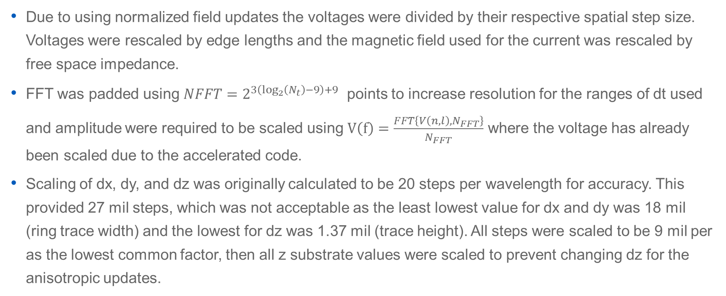
Scaling
Due to using normalized field updates the voltages were divided by their respective spatial step size. Voltages were rescaled by edge lengths and the magnetic field used for the current was rescaled by free space impedance.
FFT was padded using $NFFT=2^{3\left(\log_{2}\left(N_{t}\right)−9\right)+9}$ points to increase resolution for the ranges of dt used and amplitude were required to be scaled using $V\left(f\right)=\frac{FFT\left\{V\left(n,l\right),N_{FFT}\right\}}{N_{FFT}}$ where the voltage has already been scaled due to the accelerated code.
Scaling of dx, dy, and dz was originally calculated to be 20 steps per wavelength for accuracy. This provided 27 mil steps, which was not acceptable as the least lowest value for dx and dy was 18 mil (ring trace width) and the lowest for dz was 1.37 mil (trace height). All steps were scaled to be 9 mil per as the lowest common factor, then all z substrate values were scaled to prevent changing dz for the anisotropic updates.

Slide 8
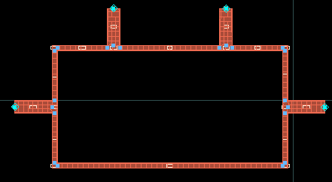
ADS MoM Schematic
Advanced Desing Studio is a powerful too for Spice and EM simulations.
ADS’ EM simulator uses MoM (Method of Moment) which is optimal for frequency domain linear matrix operations such as S-parameters and is why it is commonly used for PCB design.
This schematic was first designed in spice and then auto-generated in the EM layout window.

Slide 9
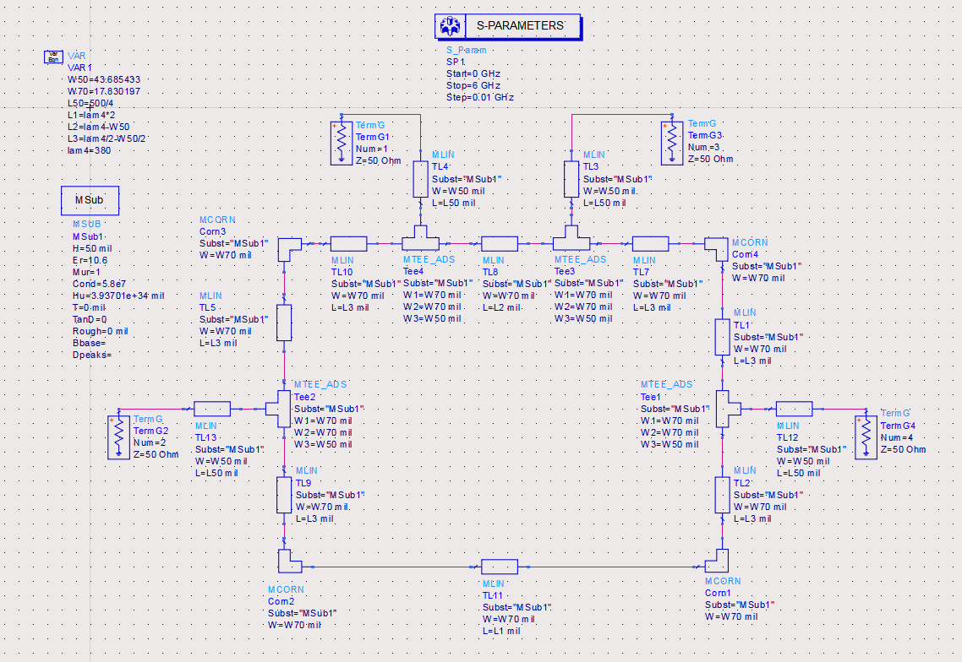
ADS Spice Schematic
Spice uses discrete numerical calculations of lumped element in the time domain then converts the signal to frequency domain parameters.
Line values for Spice solver are input as variables for ease of design.
Substrate values are declared for S-parameter simulation.
Components and variables are carefully designed for continuity since not accounting for port widths on tee connectors can generate ineffective EM layouts.

Slide 10
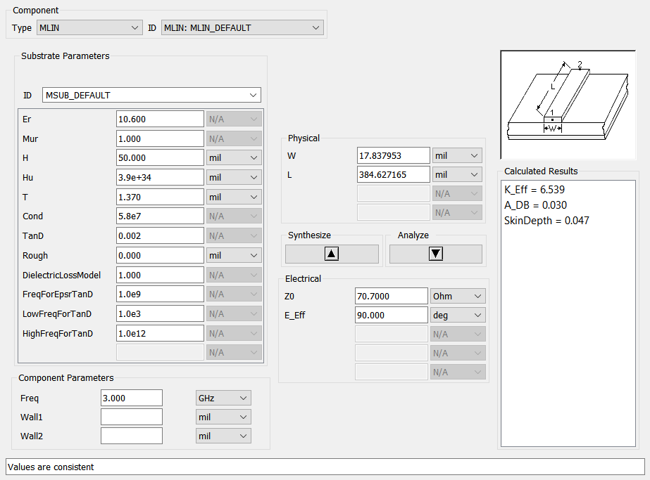
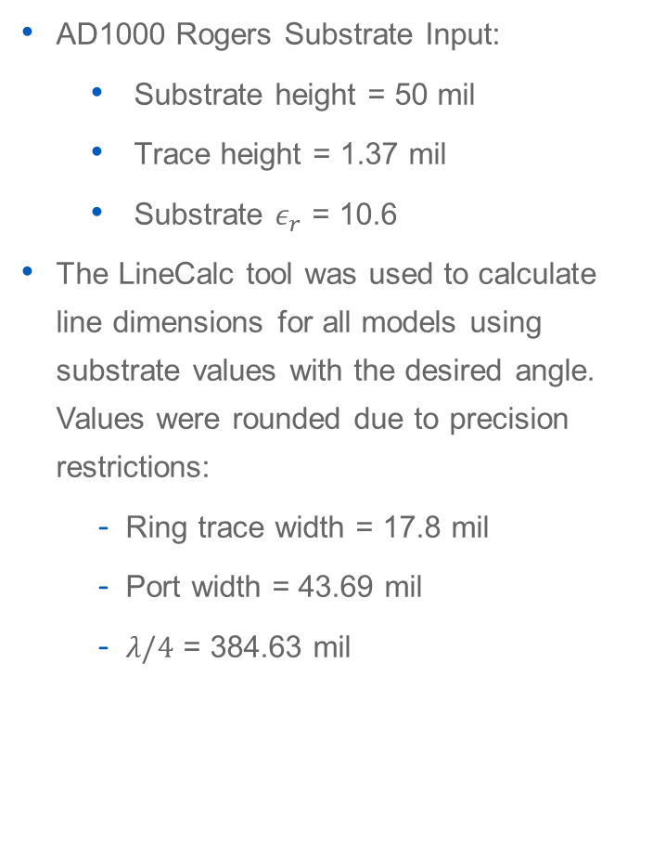
ADS LineCalc
AD1000 Rogers Substrate Input:
Substrate height = 50 mil
Trace height = 1.37 mil
Substrate $ε_{r}$ = 10.6
The LineCalc tool was used to calculate line dimensions for all models using substrate values with the desired angle. Values were rounded due to precision restrictions:
Ring trace width = 17.8 mil
Port width = 43.69 mil
$λ/4$ = 384.63 mil

Slide 11
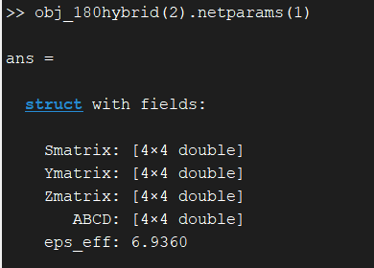
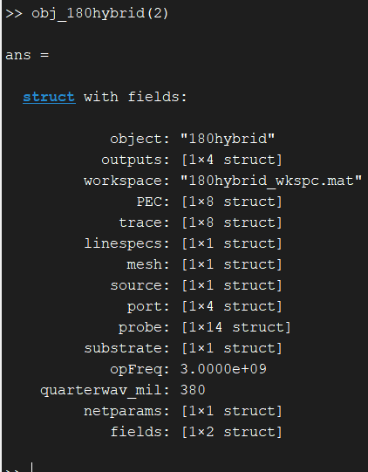
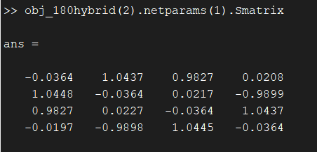
Output Parameters
Line Impedance for Ports
Scattering Parameters
Z-matrix for Design Frequency
Port Reflection Coefficients
Effective Permittivity of Substrate
Reference Time Domain Voltage and Current

Slide 12
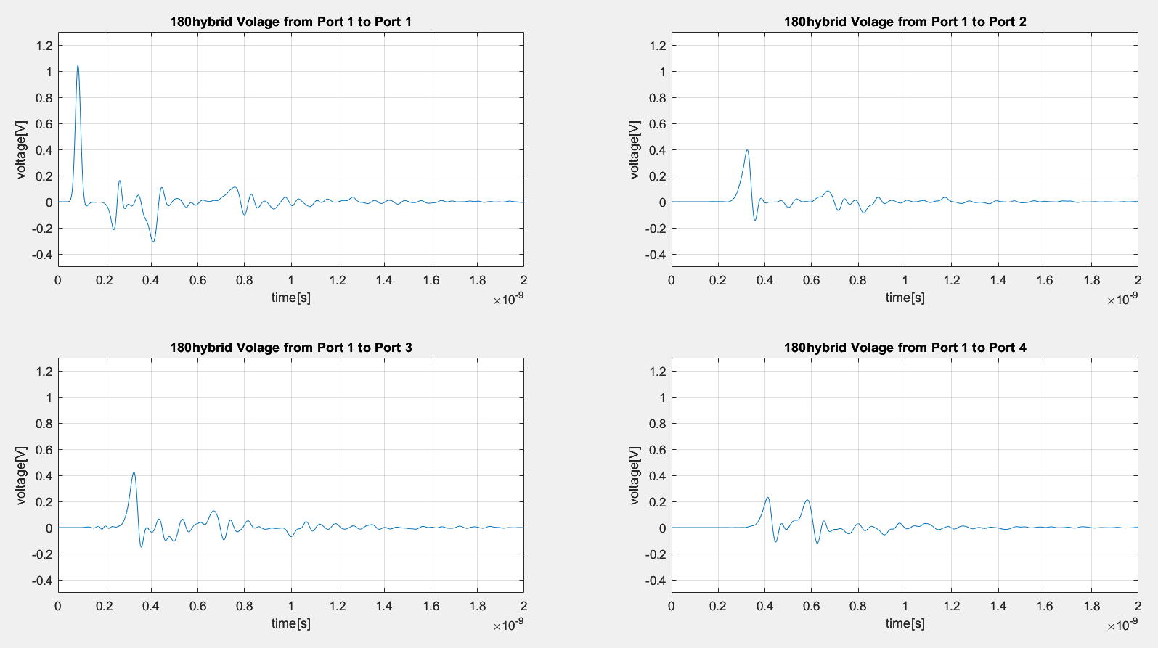
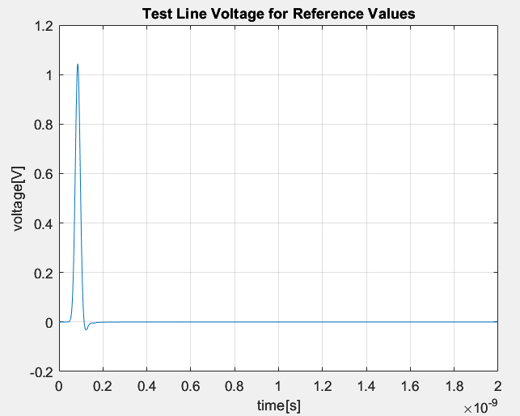
Voltage Probe Results
The forward voltage was used to isolate the true reflection signal from the source port.
Probe voltages provided expected results with some Gibbs-like aliasing from the line.
The forward voltage from the line test used for reflection loss calc is below.

Slide 13
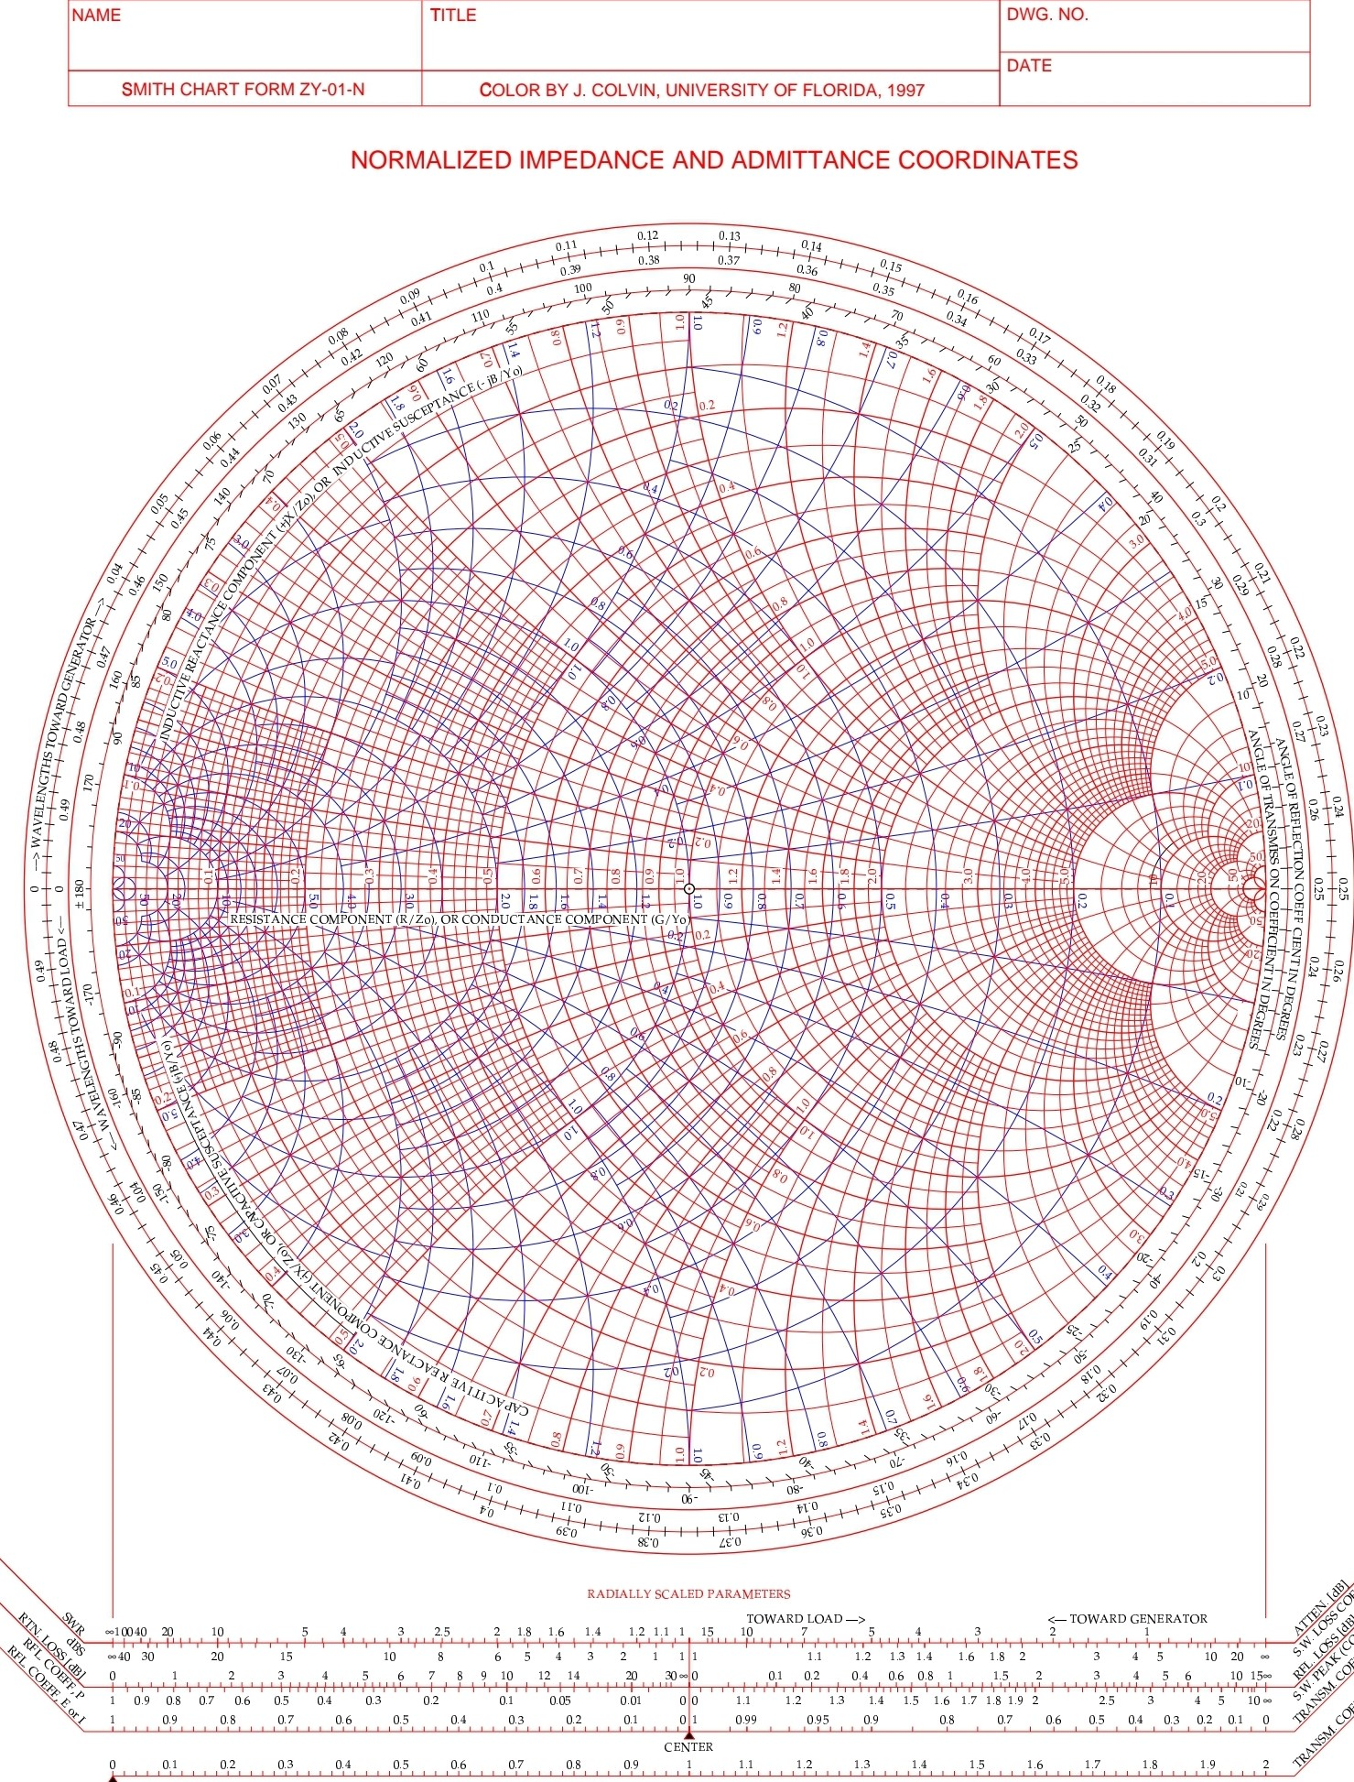
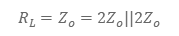
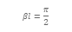

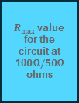

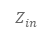

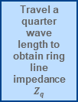
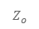
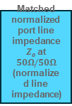
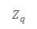
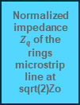
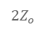
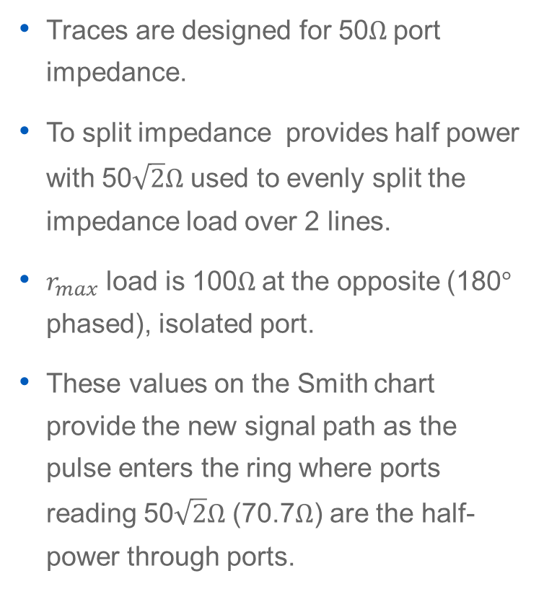
Impedances (for reference)
Traces are designed for 50$Ω$port impedance.
To split impedance provides half power with 50$\sqrt{2}Ω$ used to evenly split the impedance load over 2 lines.
$r_{max}$ load is 100$Ω$at the opposite (180$°$ phased), isolated port.
These values on the Smith chart provide the new signal path as the pulse enters the ring where ports reading 50$\sqrt{2}Ω$ (70.7$Ω$) are the half-power through ports.
Travel to half impedance due to parallel split at ring input
Travel a quarter wave length to obtain ring line impedance $Z_{q}$
$$2Z_{o}$$
Matched normalized port line impedance $Z_{o}$at $50Ω/50Ω$ (normalized line impedance)
$$R_{L}=Z_{o}=2Z_{o}||2Z_{o}$$
$$2Z_{o}$$
$$Z_{q}$$
ring
$$βl=\frac{π}{2}$$
$$Z_{o}$$
port
$$Z_{q}$$
ring
$$Z_{in}$$
Normalized impedance $Z_{q}$ of the rings microstrip line at sqrt(2)Zo
$R_{max}⁡$value for the circuit at 10$0Ω/50Ω$ ohms

Slide 14
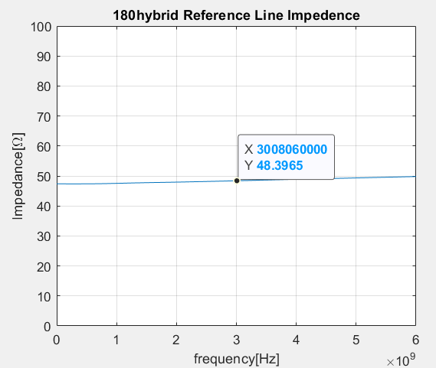
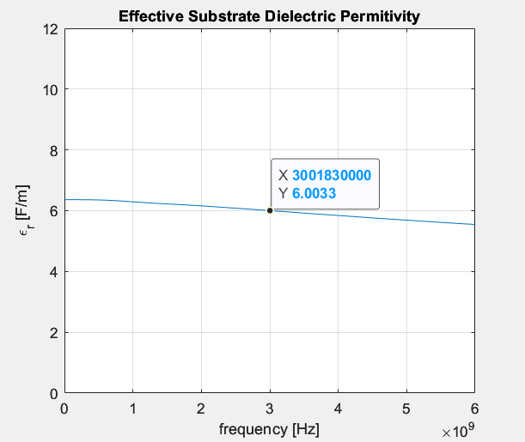
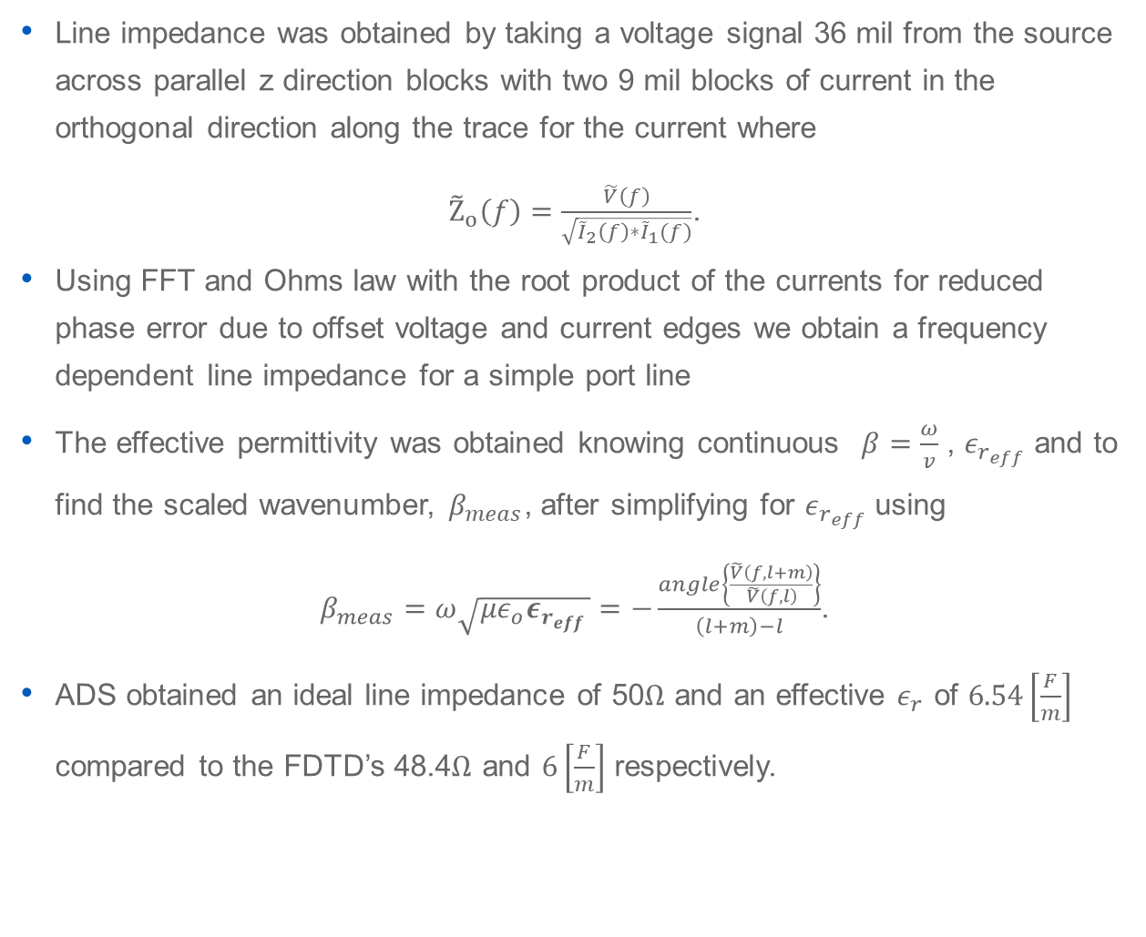

Port $Z_{o}$ and Substrate${ ε}_{eff}$ at 3GHz
Line impedance was obtained by taking a voltage signal 36 mil from the source across parallel z direction blocks with two 9 mil blocks of current in the orthogonal direction along the trace for the current where
${\tilde{Z}}_{o}\left(f\right)=\frac{\tilde{V}\left(f\right)}{\sqrt{{\tilde{I}}_{2}\left(f\right)∗{\tilde{I}}_{1}(f)}}$.
Using FFT and Ohms law with the root product of the currents for reduced phase error due to offset voltage and current edges we obtain a frequency dependent line impedance for a simple port line
The effective permittivity was obtained knowing continuous $β=\frac{ω}{v}$ , $ε_{r_{eff}}$ and to find the scaled wavenumber, $β_{meas}$, after simplifying for $ε_{r_{eff}}$ using
$β_{meas}=ω\sqrt{{με}_{o}ε_{r_{eff} }}=−\frac{angle\left\{\frac{\tilde{V}\left(f,l+m\right)}{\tilde{V}\left(f,l\right)}\right\}}{\left(l+m\right)−l}$.
ADS obtained an ideal line impedance of 50$Ω$ and an effective $ε_{r}$ of $6.54\left[\frac{F}{m}\right]$ compared to the FDTD’s 48.4$Ω$ and $6\left[\frac{F}{m}\right]$ respectively.

Slide 15
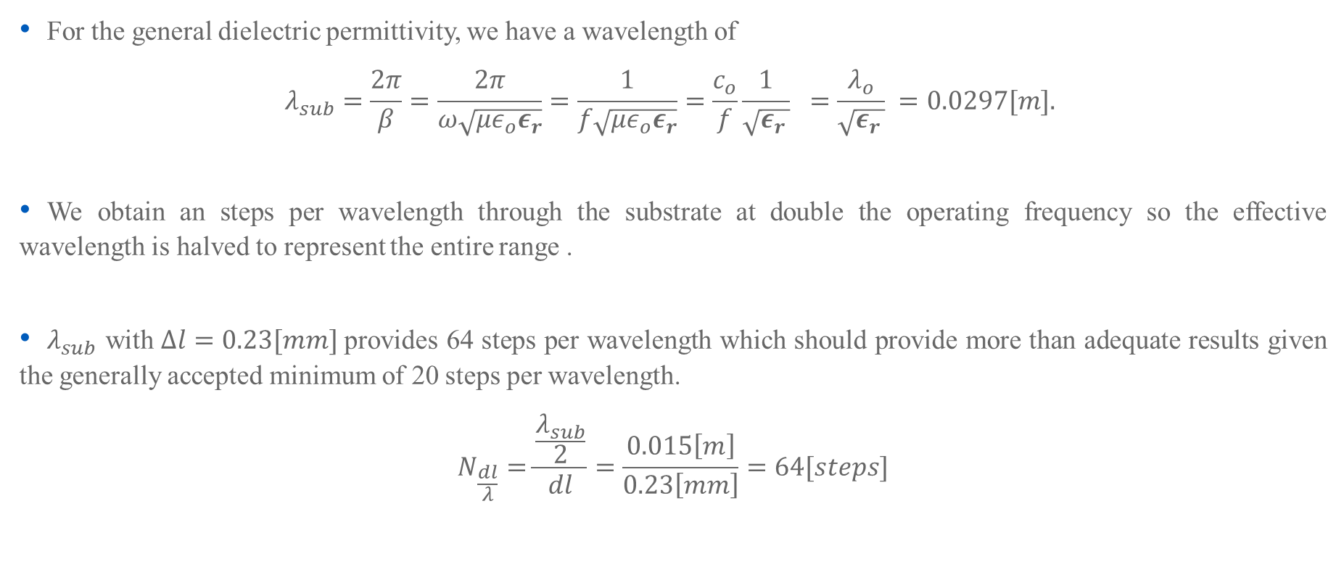
Steps Per Wavelength
For the general dielectric permittivity, we have a wavelength of
$$λ_{sub}=\frac{2π}{β}=\frac{2π}{ω\sqrt{{με}_{o}ε_{r}}}=\frac{1}{f\sqrt{{με}_{o}ε_{r}}}=\frac{c_{o}}{f}\frac{1}{\sqrt{ε_{r }}} =\frac{λ_{o}}{\sqrt{ε_{r }}} =0.0297[m].$$
We obtain an steps per wavelength through the substrate at double the operating frequency so the effective wavelength is halved to represent the entire range .
$λ_{sub}$ with $Δl=0.23[mm]$provides 64 steps per wavelength which should provide more than adequate results given the generally accepted minimum of 20 steps per wavelength.
$$N_{\frac{dl}{λ}}=\frac{\frac{λ_{sub}}{2}}{dl}=\frac{0.015\left[m\right]}{0.23\left[mm\right]}=64[steps]$$

Slide 16
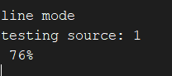
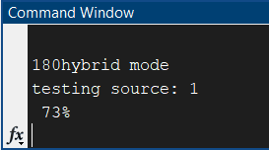
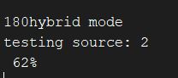
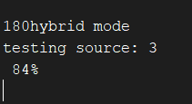
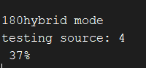
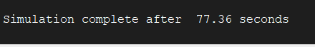
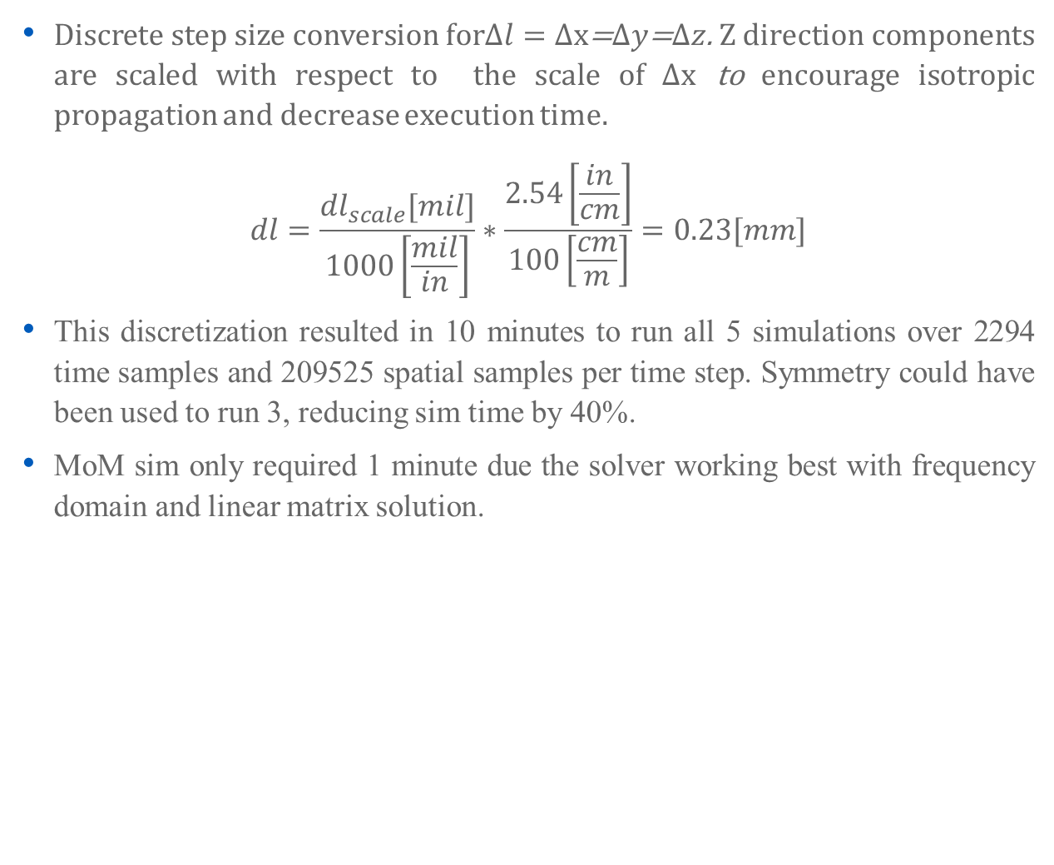
Step Size and Sim Time
Discrete step size conversion for$Δl=Δx$=$Δy$=$Δz$. Z direction components are scaled with respect to the scale of $Δx$ to encourage isotropic propagation and decrease execution time.
$$dl=\frac{{dl}_{scale}[mil]}{1000\left[\frac{mil}{in}\right]}∗\frac{2.54\left[\frac{in}{cm}\right]}{100\left[\frac{cm}{m}\right]}=0.23[mm]$$
This discretization resulted in 10 minutes to run all 5 simulations over 2294 time samples and 209525 spatial samples per time step. Symmetry could have been used to run 3, reducing sim time by 40%.
MoM sim only required 1 minute due the solver working best with frequency domain and linear matrix solution.

Slide 17
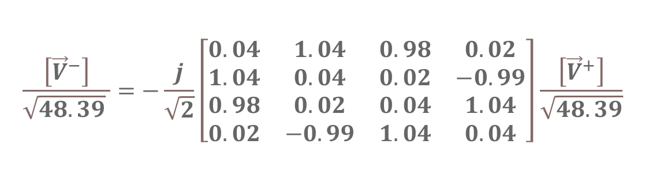
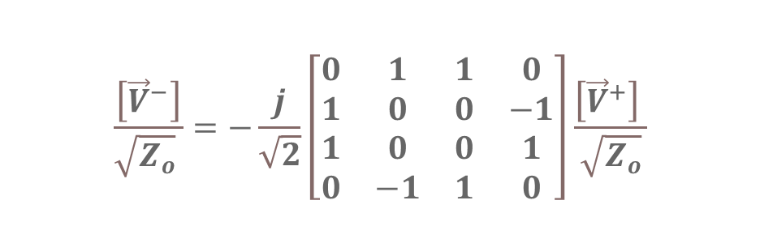
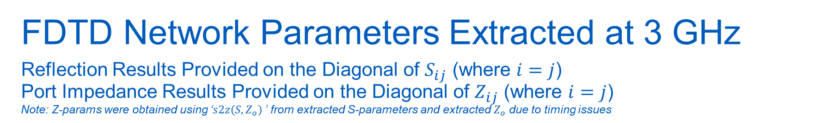


FDTD Network Parameters Extracted at 3 GHz Reflection Results Provided on the Diagonal of $S_{ij}$ (where $i=j$) Port Impedance Results Provided on the Diagonal of $Z_{ij}$ (where $i=j$) Note: Z-params were obtained using ‘$s2z\left(S,Z_{o}\right)$’ from extracted S-parameters and extracted $Z_{o}$ due to timing issues
Ideal SCATTERING PARAMETERS
Result FDTD SCATTERING parameters
$$\frac{\left[{\vec{V}}^{−}\right]}{\sqrt{Z_{o}} }=−\frac{j}{\sqrt{2}}\left[\begin{matrix}0 & 1 & 1 & 0 \\ 1 & 0 & 0 & −1 \\ 1 & 0 & 0 & 1 \\ 0 & −1 & 1 & 0\end{matrix}\right]\frac{\left[{\vec{V}}^{+}\right] }{\sqrt{Z_{o}}}$$
$$\frac{\left[{\vec{V}}^{−}\right]}{\sqrt{48.39} }=−\frac{j}{\sqrt{2}}\left[\begin{matrix}0.04 & 1.04 & 0.98 & 0.02 \\ 1.04 & 0.04 & 0.02 & −0.99 \\ 0.98 & 0.02 & 0.04 & 1.04 \\ 0.02 & −0.99 & 1.04 & 0.04\end{matrix}\right]\frac{\left[{\vec{V}}^{+}\right]}{\sqrt{48.39}}$$
Ideal impedance PARAMETERS
Result FDTD impedance parameters
$$\left[\vec{V}\right]=\left[\begin{matrix}50 & 70.7 & 70.7 & 100 \\ 70.7 & 50 & 100 & 70.7 \\ 70.7 & 100 & 50 & 70.7 \\ 100 & 70.7 & 70.7 & 50\end{matrix}\right]\left[\vec{I}\right]$$
$$\left[\vec{V}\right]=\left[\begin{matrix}51.65 & 68.99 & 72.71 & 99.35 \\ 69.17 & 52.2 & 99.51 & 73.2 \\ 72.73 & 99.35 & 51.5 & 68.99 \\ 99.52 & 73.2 & 69.15 & 52.32\end{matrix}\right]\left[\vec{I}\right]$$

Slide 18
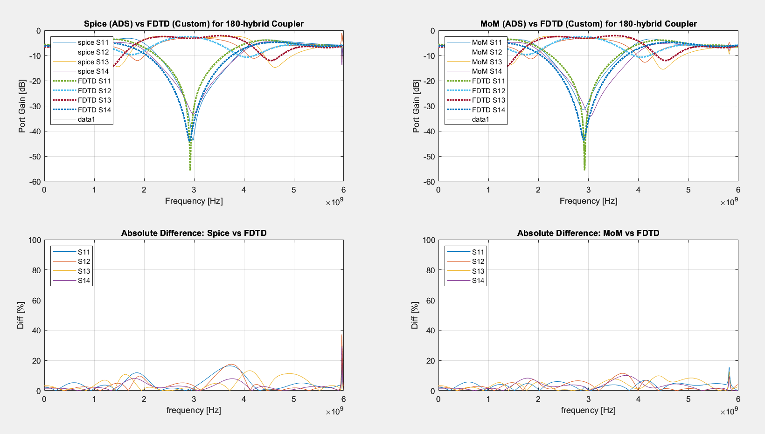

Slide 19
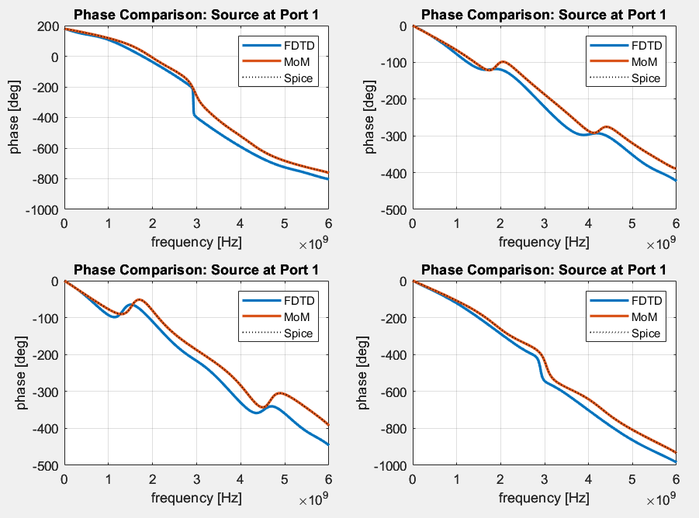
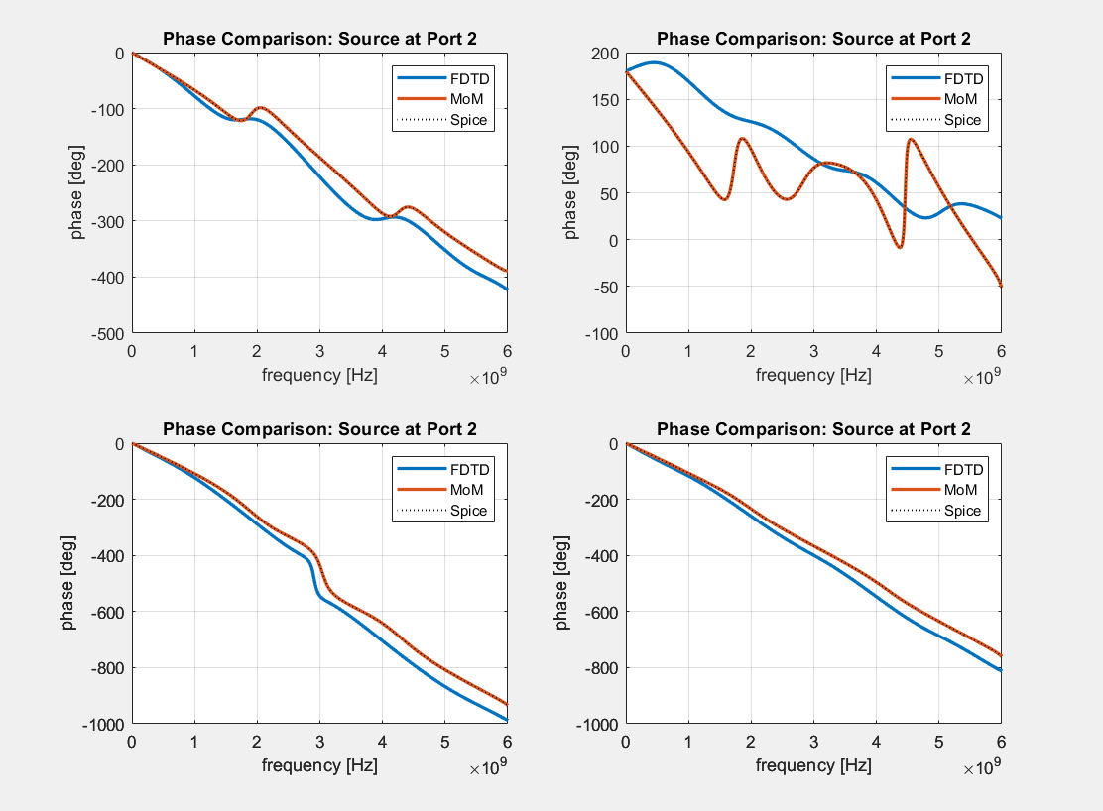
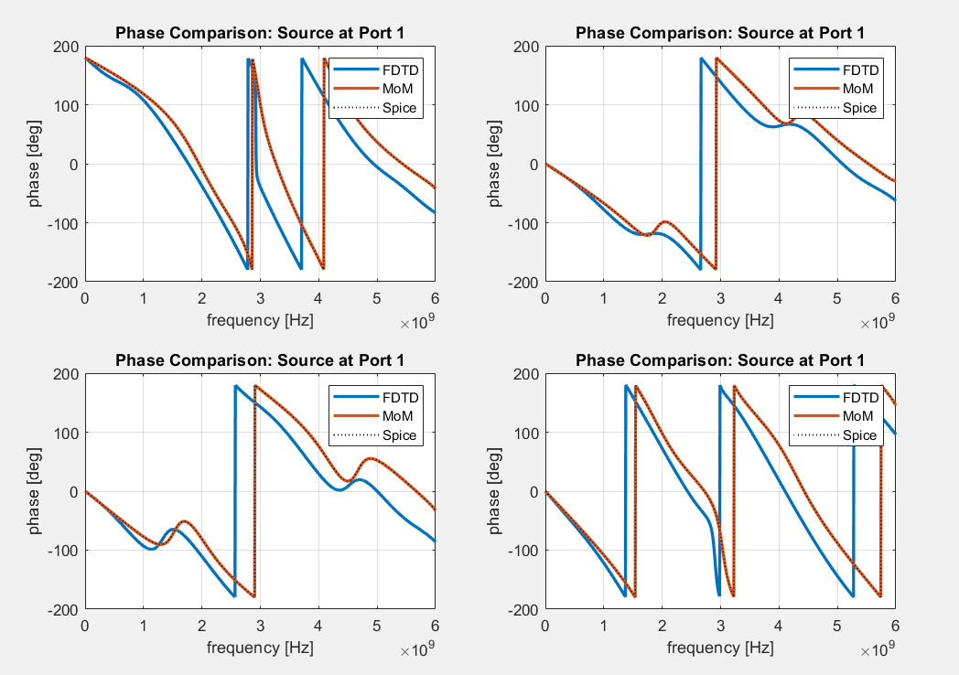


Slide 20
Error
Results show likely probing error given the 4% gain above half power for S34, S43, S12 and S21. It could also be discretization error in the port spacing.
High lobes on return loss indicates there is a better method for extracting the return signal. The lobe distortion as frequencies increase could be due to increasing phase and frequency error evident in the phase phots as frequency increases.
Error is greatest at ports 2 and 4 in the phase plots, this could be the source of the 4% gain previous mention due to probing/reference error.
There was max normalized relative difference of 20% between the Spice and FDTD models with a mean of 5%. There was a max variation of 10% between the MoM and FDTD models with a mean of 5%. The results between MoM and FDTD are of highest interest due to both being the EM simulations which had half the error as the Spice comparison.

